Slide 1
Content Objective: Students will construct a logical argument for the potential social impacts of AI.
Monday June 17th
Introduction
The Ethics of AI
Day 1 - Social Impact
Homework
No homework in the course. But I will make you think!
Feel free to write and speak in your native language when I ask you questions. If there is someone next to you that you can translate for please do!

Slide 2
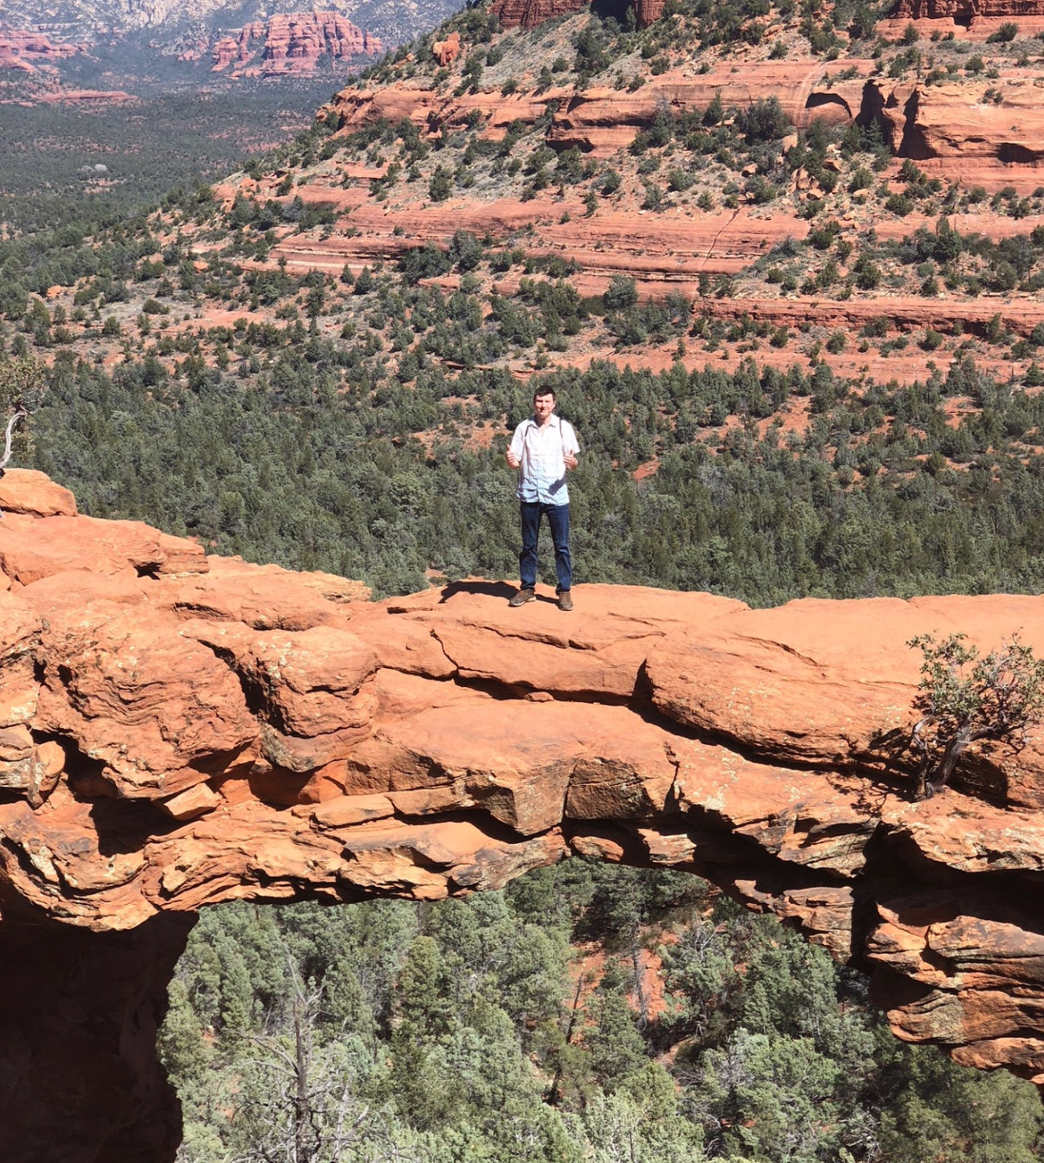

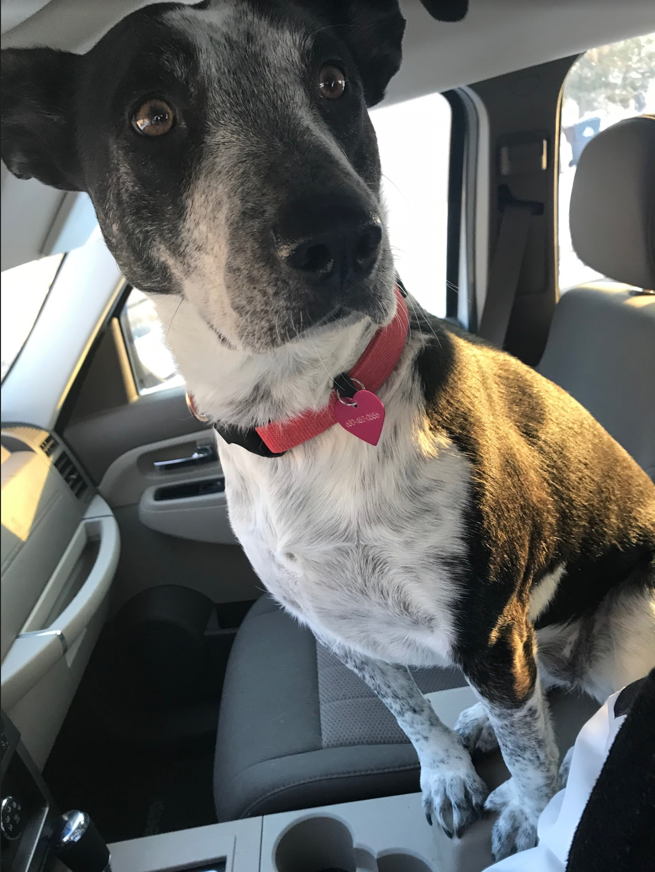

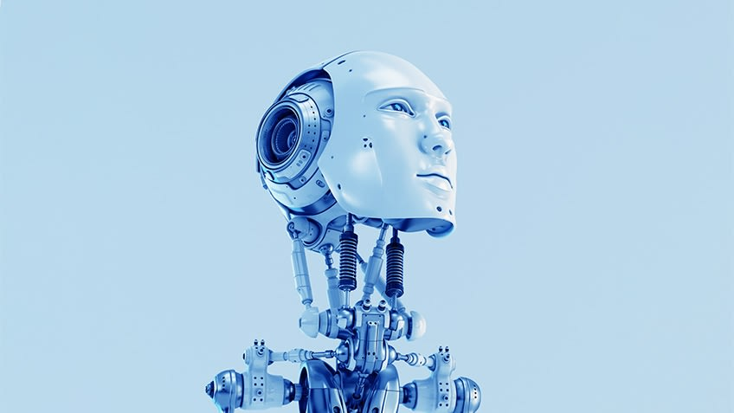
Introduction - Matt Turner
Middle / High School Science Teacher

Slide 3
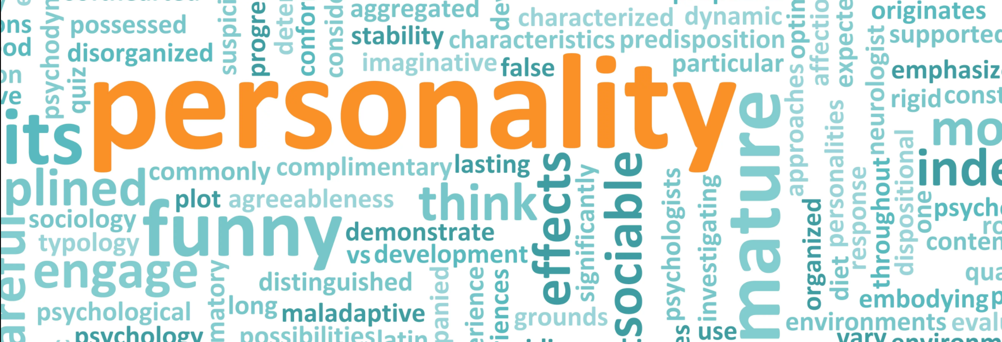
On a scrap of paper….
Tell me about yourself!
This can be anything that can help me get to know you better. It can be as interesting or as basic as you want it to be.

Slide 4
General Plan and Guidelines for the Week
Guidelines:
As this is a pre-collegiate program I plan on treating you with the same level of respect as a college level student.
Students in college cooperate and collaborate together, are excited to learn, and generally want to be here. Let’s make this class feel the same way!
General Plan...
Day 1 - Social Impact
Day 2 - Perception
Day 3 - Representation and Reasoning
Day 4 - Learning
Day 5 - Natural Interaction

Slide 5



AI & Ethics
What do we already know about AI & Ethics? Let’s define AI / Ethics...

Slide 6
First Assignment - Your Ethical Code
On a sheet of paper construct a set of values for yourself.
What do you consider to be evil, neutral, and good? Come up with different scenarios, consider whether you agree with what the U.S. thinks is good or bad, what does your family think is good or bad, talk to your table partners about what is deemed good or bad. But this list should be what YOU think, personally.
Organize a list in this way....
“Evil” “Neutral” “Good”

Slide 7
Day 1 - Social Impact
Why is it important to consider ethics and AI?
What is society? What do we view as being a good or bad society?
Who are the ones making the machines? Programming the machines? As we will learn later on, AI learns from us...are we always a good example?
See Hanson Robotics Website ----> Sophia
What might the ethical code of these people be as they create this robot?
Do you think they have similar or different ethics to us here in the classroom?

Slide 8
Scenario 1 - The Day the Yogurt Took Over
Scenario 2 - The Second Renaissance (9 min in)
Scenario 3 - Sophia Talks About Her Plan
Let’s look at three different societal scenarios...categorize these as being either “evil,” “neutral,” or “good.” Come up with reasons why you feel these outcomes are good or bad and be ready to defend your thinking. Jot down significant moments that seem to go against (or with) your own ethical code.

Slide 9
Which Scenario do you believe is the most likely?
Get in a group of 2-3 and construct an argument for which one of these scenarios you believe is the most likely to play out in the future. Compare / contrast your ethical codes to help guide you. Write 2-3 paragraphs to defend your reasoning.
The goal of this course is to ensure that as the creators of Artificial Intelligence we have the power to determine which outcome we desire.
But if we can not come to an agreement on what we consider to be good or bad then AI might construct its own argument…is this dangerous?

Slide 10
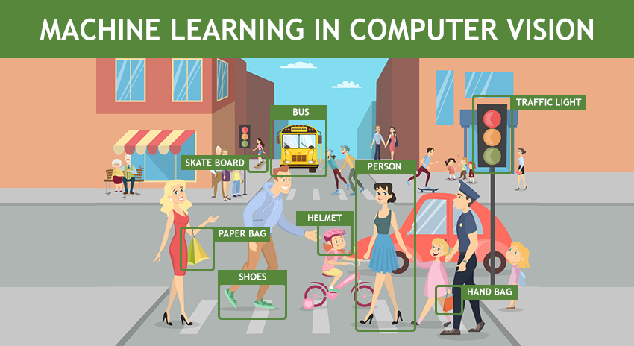

Tomorrow - Perception
What is Artificial Intelligence actually?
Computer Vision
How does a computer “see”?
Ethics of Perception

